Slide 1

Titanic Project

Slide 2

Hello!
Zia Khan
zia@thedevmasters.com

Slide 3
CRISP-DM
1
Business Objective
2
Data Understanding
3
Data Preparation
4
Modeling
5

Slide 4

CRISP-DM
Overview
Business Understanding
Data Understanding
Data Preparation
Modeling
Evaluation
Deployment

Slide 5
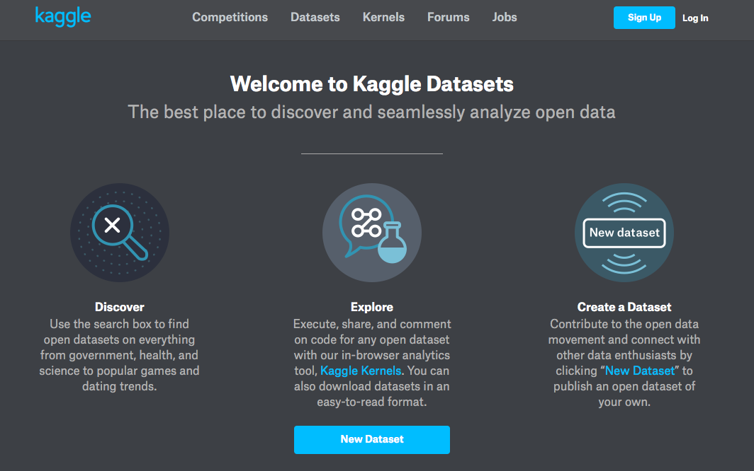
Kaggle Competitions

Slide 6
CRISP-DM
1
Business Objective
2
Data Understanding
3
Data Preparation
4
Modeling
5

Slide 7
2. Objective
We are going to predict who is going to survive, based on the Titanic dataset

Slide 8
CRISP-DM
1
Business Objective
2
Data Understanding
3
Data Preparation
4
Modeling
5

Slide 9
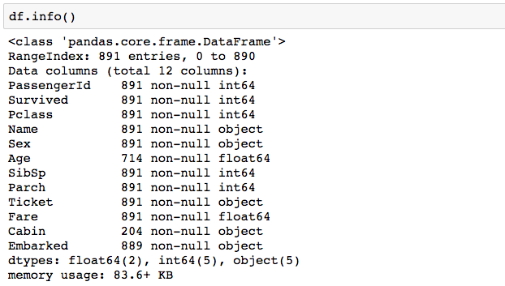
Data Understanding

Slide 10
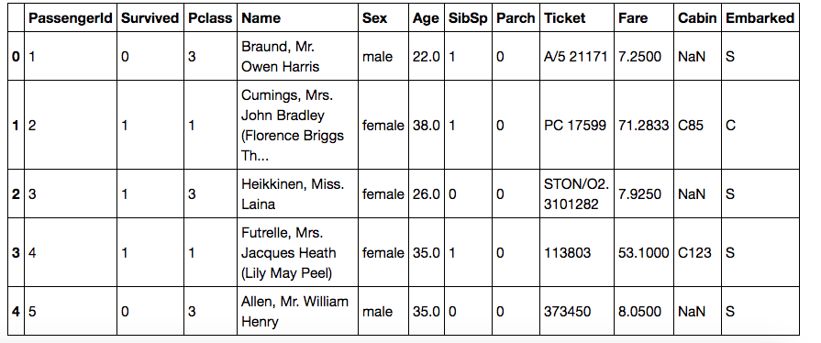
Data Understanding

Slide 11
CRISP-DM
1
Business Objective
2
Data Understanding
3
Data Preparation
4
Modeling
5

Slide 12
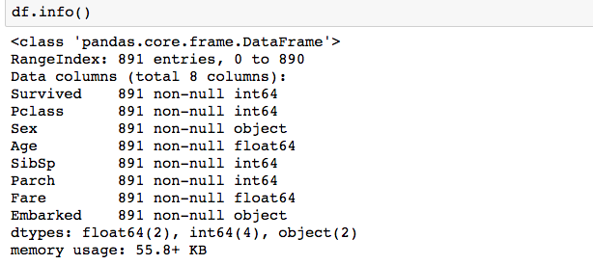
Data Preparation

Slide 13
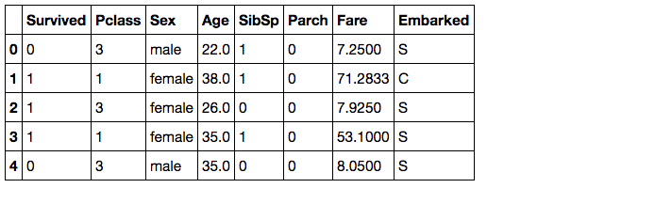
Data Preparation

Slide 14
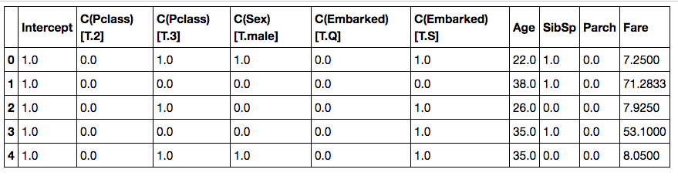
Data Preparation

Slide 15
CRISP-DM
1
Business Objective
2
Data Understanding
3
Data Preparation
4
Modeling
5

Slide 16
Modeling
Algorithm Selection
Depending on the question at hand you can decide which algorithm to choose
Classification Question
Estimation Question

Slide 17
Titanic Project
Combine (train and test)
Data preparation
Split training data (train and test)
Algorithm selection
Training
Predict
Measure accuracy
Predict on test dataset
Submit your predictions to Kaggle
Rank in top 40%

Slide 18
Thanks!!
Any questions?
zia@thedevmasters.com

